Slide 1
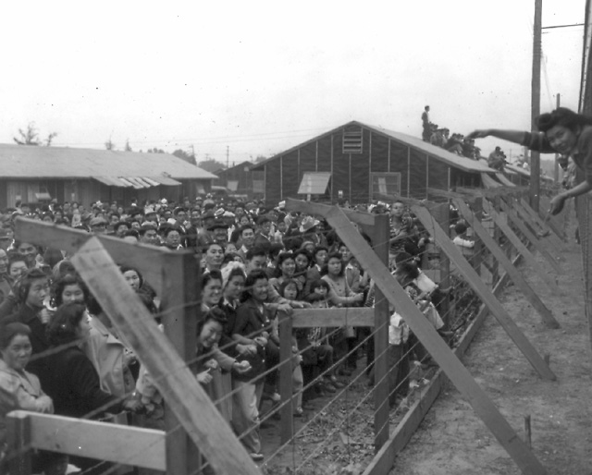
Japanese Internment

Slide 2
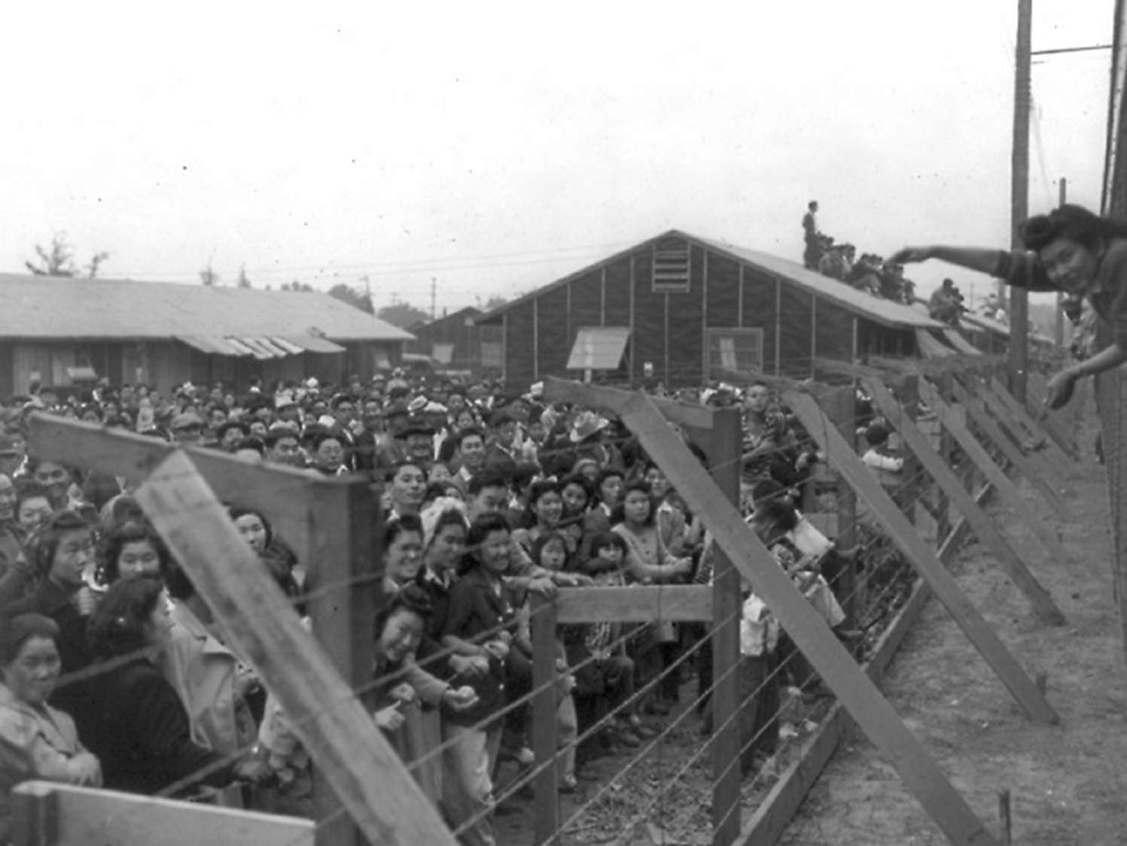
Internment
Internment is the imprisonment or confinement of people, commonly in large groups, without trial.

Slide 3
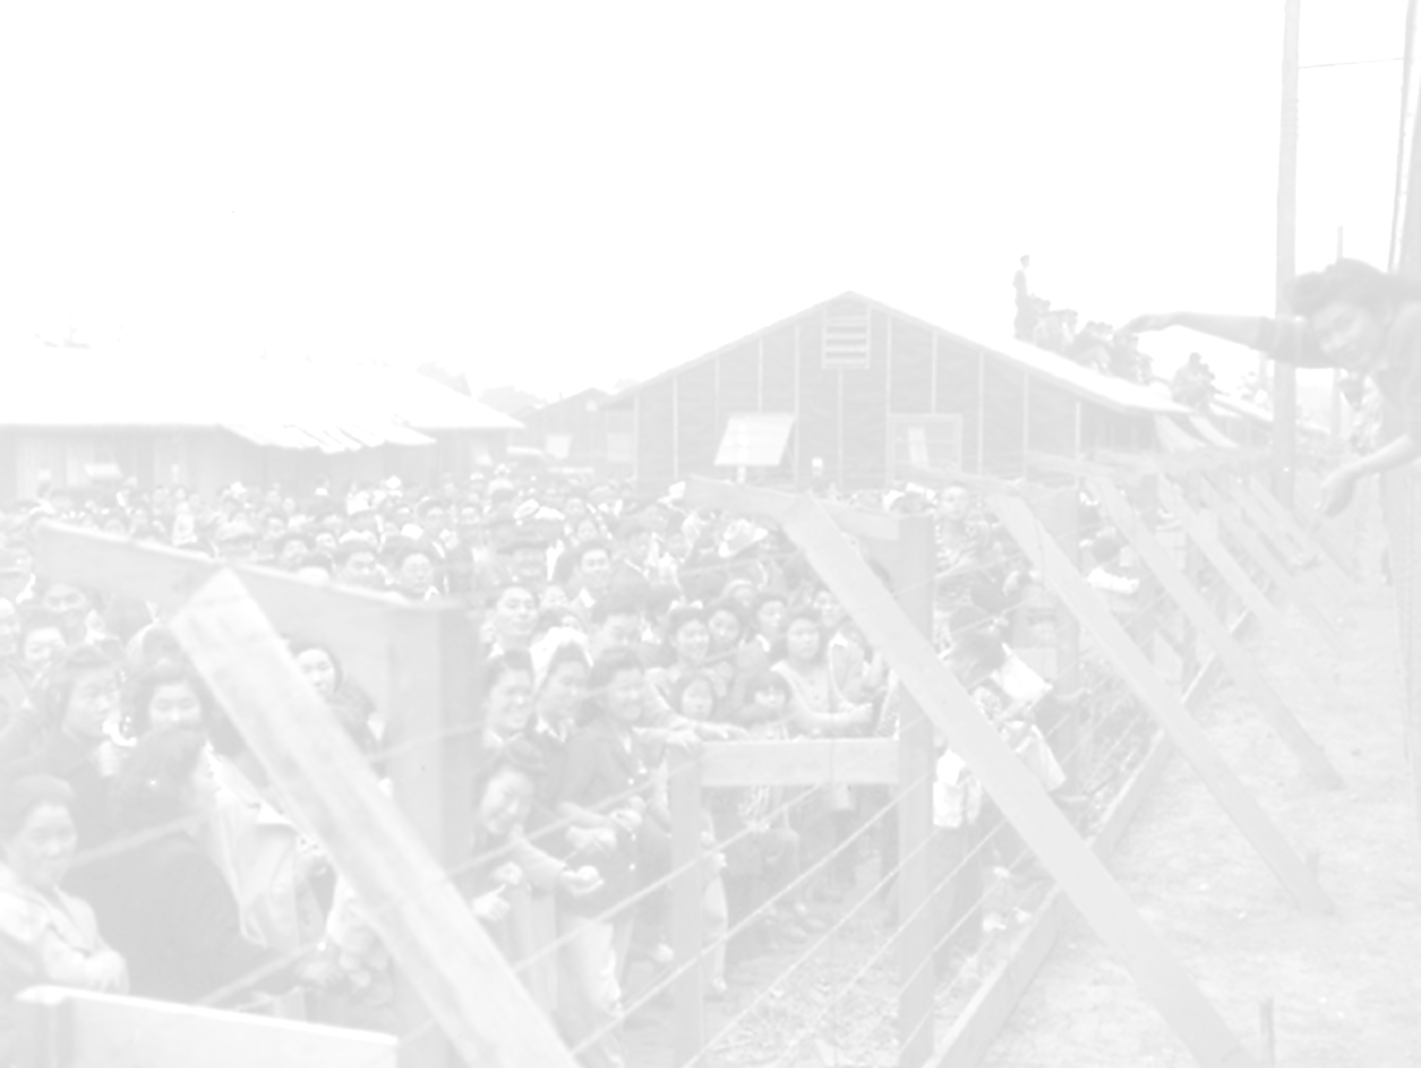
Who should qualify for internment?

Slide 4
Japanese in the U.S. (a very brief history)
1891 – immigrants arrive
Agricultural laborers
1924 – Immigration Act
Ended Japanese immigration to U.S.
1941 – Pearl Harbor attacked
1942 – Internment enacted
Executive Order 9066

Slide 5
Government Newsreel
Made in 1942
Explained the gov’ts strategies for internment
Questions to consider:
What were some reasons for internment offered by the newsreel?
How does the newsreel portray internment?
Who do you think the intended audience was for this newsreel?
Notes:
https://www.youtube.com/watch?v=VrXht2h4BrU

