Slide 1
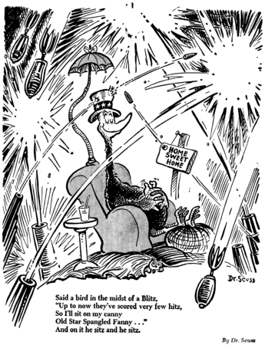
Road to WWII – Fo Po, y’all!
Politics of the 1930s

Slide 2
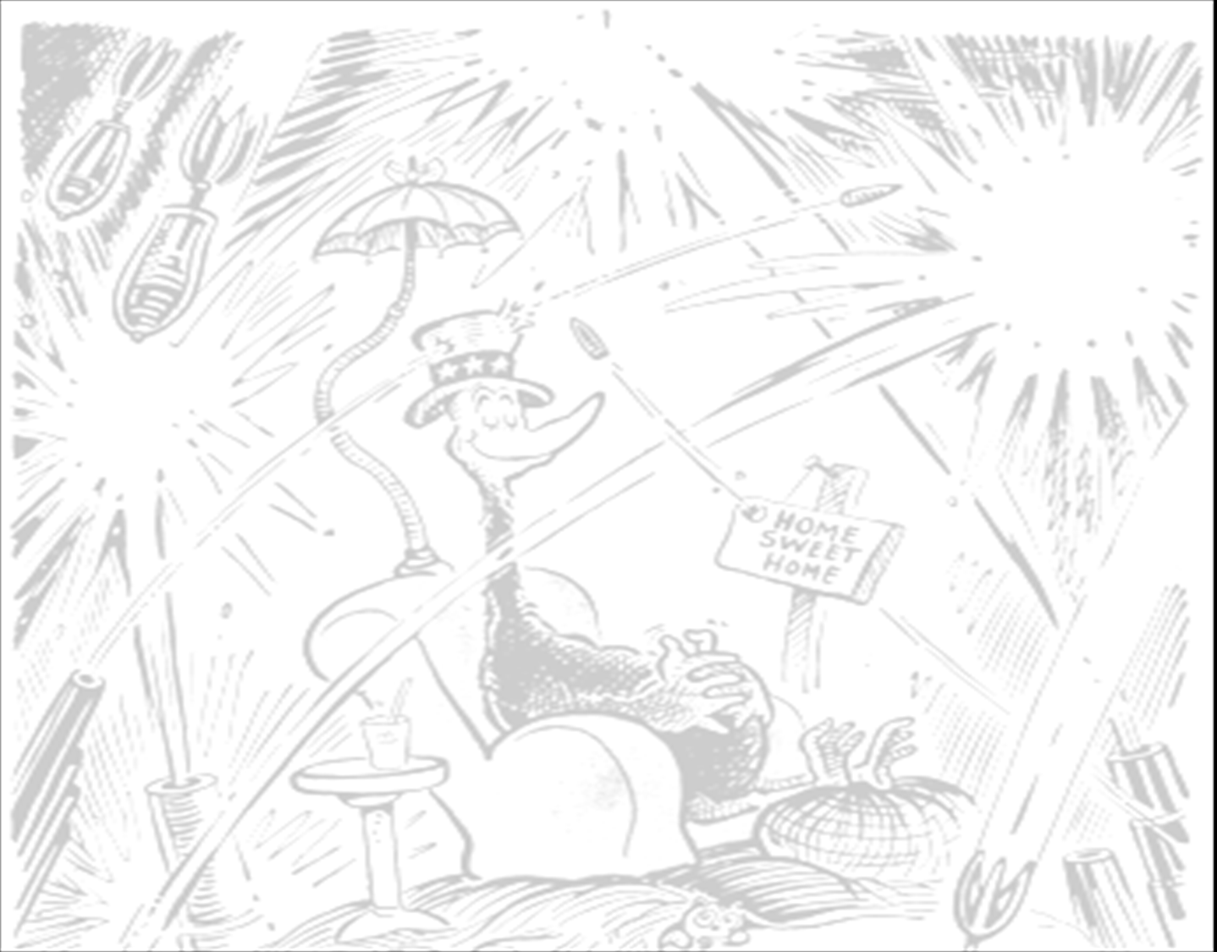
Foreign Policy
How we relate to other countries
What are some examples?
Monroe Doctrine
Imperialism
Isolationism
World Police

Slide 3
Rise of Hitler
Read the article titled, “Nazi Germany” to answer these questions for your notes.
Why did the Weimar Republic fail?
Why did the Depression create so much violence in Germany?
What was Mein Kampf?

Slide 4
GET IT?!

Slide 5
Isolationism
Non-involvement
Non-entanglement
Costs of WWI
Great Depression
Suspicions of wartime profiteering

Slide 6
America First
put pressure on Roosevelt to uphold the Neutrality Acts
Charles Lindbergh
"Aid short of war" weakens national defense at home and threatens to involve America in war abroad.

Slide 7
Neutrality Acts
Year | Neutrality Act | World Event
1935 | prohibit export of “arms, ammunition, and implements of war” from US to foreign nations | Japanese aggression, rise of Hitler
1937 | US merchants can carry arms to belligerents | Spanish Civil War, rise of fascism (Italy)
1939 | lifted the arms embargo and put all trade with belligerent nations under “cash-and-carry” | Germany becoming aggressive

Slide 8
Lend-Lease Act (1941)
Roosevelt: “Neutral in law but not in thought.”
Support to countries fighting fascism
UK, especially!
“lend” the supplies to the British, deferring payment

Slide 9
Contradiction of Lend-Lease…
How does the Lend-Lease Act of 1941 contradict the policy of Isolationism and the Neutrality Acts?

